Slide 1

Unit 4
LINUX Fundamentals
Image source: https://www.itdev.co.uk/blog/get-your-patch-merged-journey-linux-kernel-%E2%80%93-part-3
Notes:
1

Slide 2
Objective
Introduction to Linux Kernel
Linux Architecture
History of Linux
Linux Features
Kernel Design Goals

Slide 3

What is Linux Kernel?
The Linux kernel is a free and open-source, monolithic, modular, multitasking, Unix-like operating system kernel.
It was conceived and created in 1991 by Linus Torvalds for his i386-based PC, and it was soon adopted as the kernel for the GNU operating system, which was created as a free replacement for UNIX.
https://en.wikipedia.org/wiki/Linux_kernel
Notes:
Discuss various definitions of AI. Sum it up in the end using a simple language.
“A branch of computer science dealing with the simulation of intelligent behaviour in computers.” (Merriam-Webster)
“A program that can sense, reason, act, and adapt.” (Intel).
“Colloquially, the term ‘artificial intelligence’ is applied when a machine mimics ‘cognitive’ functions that humans associate with other human minds, such as ‘learning' and ‘problem solving’.” (Wikipedia)
To sum it up, Artificial Intelligence is a constellation of technologies that enables machines to act with a higher level of intelligence and display human capabilities of sense, comprehend, and act.
3

Slide 4
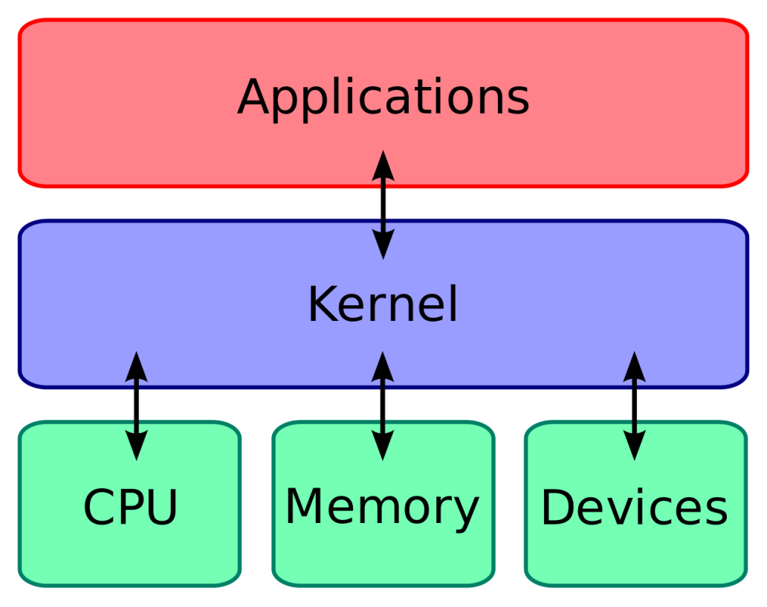
What is a Kernel?
Kernel runs each processes and provides system services to processes, provides protected access to hardware to processes.
The kernel has following jobs:
Memory management
Process management
Device drivers
System calls and security
https://blog.digilentinc.com/wp-content/uploads/2015/05/1280px-Kernel_Layout.svg_.png
Notes:
Talk about most prominent areas where AI is already being used. Give examples

Slide 5
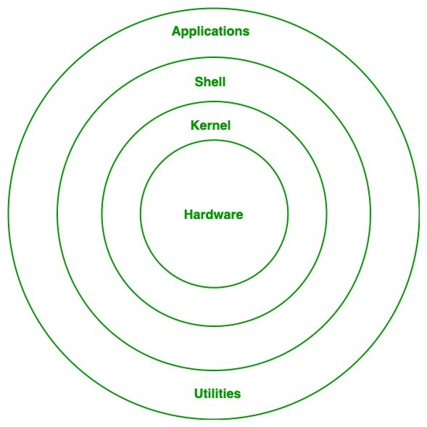
Linux Architecture
Hardware Layer
Kernel
Shell
Utilities
https://media.geeksforgeeks.org/wp-content/uploads/20200105215737/Untitled-Diagram-215-1.jpg
Notes:
Talk about most prominent areas where AI is already being used. Give examples

Slide 6
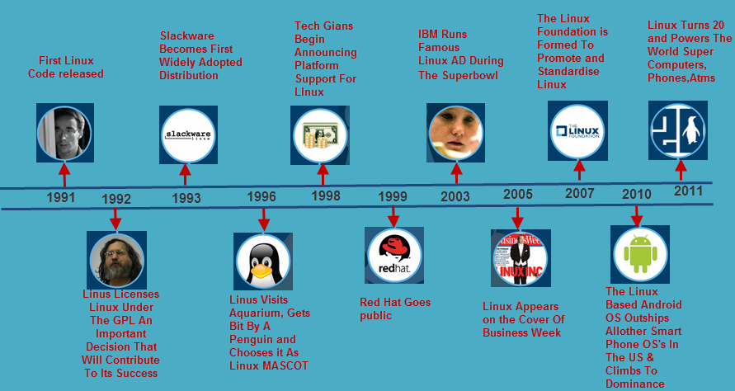
History of Linux
Source: https://www.elprocus.com/linux-operating-system/

Slide 7
Linux Features
UNIX-like kernel.
Features:
Open source.
Preemptive multitasking.
Multi-user
Hierarchical file system
Portable
Security

Slide 8
Linux Advantages
Low cost
Stability
Performance
Network friendliness
Flexibility
Compatibility
Choice
Fast and easy installation
Multi-tasking
Open Source

Slide 9






Linux Distributions

Slide 10
Kernel Design Goals
Performance: efficiency, speed.
Utilize resources to capacity with low overhead.
Stability: robustness, resilience.
Uptime, graceful degradation.
Capability: features, flexibility, compatibility.
Security, protection.
Protect users from each other & system from bad users.
Portability.
Extensibility.

Slide 11
Kernel Design
Applications
System Libraries (libc)
System Call Interface
I/O Related
Process Related
Modules
File Systems
Scheduler
Networking
Memory Management
Device Drivers
IPC
Architecture-Dependent Code
Hardware

Slide 12
Linux Source Tree Layout
Documentation
/usr/src/linux
scripts
init
ipc
kernel
net
arch
lib
mm
drivers
fs
include
acorn
atm
block
cdrom
char
dio
fc4
i2c
i2o
ide
ieee1394
isdn
macintosh
misc
net
…
802
appletalk
atm
ax25
bridge
core
decnet
econet
ethernet
ipv4
ipv6
ipx
irda
khttpd
lapb
…
alpha
arm
i386
ia64
m68k
mips
mips64
ppc
s390
sh
sparc
sparc64
adfs
affs
autofs
autofs4
bfs
code
cramfs
devfs
devpts
efs
ext2
fat
hfs
hpfs
…
asm-alpha
asm-arm
asm-generic
asm-i386
asm-ia64
asm-m68k
asm-mips
asm-mips64
linux
math-emu
net
pcmcia
scsi
video …
adfs
affs
autofs
autofs4
bfs
code
cramfs
devfs
devpts
efs
ext2
fat
hfs
hpfs …

Slide 13
Linux /arch
Subdirectories for each current port.
Each contains kernel, lib, mm, boot and other directories whose contents override code stubs in architecture independent code.
lib contains highly-optimized common utility routines such as memcpy, checksums, etc.
arch as of 2.4:
alpha, arm, i386, ia64, m68k, mips, mips64.
ppc, s390, sh, sparc, sparc64.

Slide 14
Linux /drivers
Largest amount of code in the kernel tree (~1.5M).
device, bus, platform and general directories.
drivers/char – n_tty.c is the default line discipline.
drivers/block – elevator.c, genhd.c, linear.c, ll_rw_blk.c, raidN.c.
drivers/net –specific drivers and general routines Space.c and net_init.c.
drivers/scsi – scsi_*.c files are generic; sd.c (disk), sr.c (CD-ROM), st.c (tape), sg.c (generic).
General:
cdrom, ide, isdn, parport, pcmcia, pnp, sound, telephony, video.
Buses – fc4, i2c, nubus, pci, sbus, tc, usb.
Platforms – acorn, macintosh, s390, sgi.

Slide 15
Linux /fs
Contains:
virtual filesystem (VFS) framework.
subdirectories for actual filesystems.
vfs-related files:
exec.c, binfmt_*.c - files for mapping new process images.
devices.c, blk_dev.c – device registration, block device support.
super.c, filesystems.c.
inode.c, dcache.c, namei.c, buffer.c, file_table.c.
open.c, read_write.c, select.c, pipe.c, fifo.c.
fcntl.c, ioctl.c, locks.c, dquot.c, stat.c.

Slide 16
Linux /Include
include/asm-*:
Architecture-dependent include subdirectories.
include/linux:
Header info needed both by the kernel and user apps.
Usually linked to /usr/include/linux.
Kernel-only portions guarded by #ifdefs
#ifdef __KERNEL__
/* kernel stuff */
#endif
Other directories:
math-emu, net, pcmcia, scsi, video.

Slide 17
Linux /init
Just two files: version.c, main.c.
version.c – contains the version banner that prints at boot.
main.c – architecture-independent boot code.
start_kernel is the primary entry point.

Slide 18
Linux /ipc
System V IPC facilities.
If disabled at compile-time, util.c exports stubs that simply return –ENOSYS.
One file for each facility:
sem.c – semaphores.
shm.c – shared memory.
msg.c – message queues.

Slide 19
Linux /kernels
The core kernel code.
sched.c – “the main kernel file”:
scheduler, wait queues, timers, alarms, task queues.
Process control:
fork.c, exec.c, signal.c, exit.c etc…
Kernel module support:
kmod.c, ksyms.c, module.c.
Other operations:
time.c, resource.c, dma.c, softirq.c, itimer.c.
printk.c, info.c, panic.c, sysctl.c, sys.c.

Slide 20
Linux /mm
Paging and swapping:
swap.c, swapfile.c (paging devices), swap_state.c (cache).
vmscan.c – paging policies, kswapd.
page_io.c – low-level page transfer.
Allocation and deallocation:
slab.c – slab allocator.
page_alloc.c – page-based allocator.
vmalloc.c – kernel virtual-memory allocator.
Memory mapping:
memory.c – paging, fault-handling, page table code.
filemap.c – file mapping.
mmap.c, mremap.c, mlock.c, mprotect.c.

Slide 21
Linux /lib
kernel code cannot call standard C library routines.
Files:
brlock.c – “Big Reader” spinlocks.
cmdline.c – kernel command line parsing routines.
errno.c – global definition of errno.
inflate.c – “gunzip” part of gzip.c used during boot.
string.c – portable string code.
Usually replaced by optimized, architecture-dependent routines.
vsprintf.c – libc replacement.

Slide 22
Linux /scripts
Scripts for:
Menu-based kernel configuration.
Kernel patching.
Generating kernel documentation.

Slide 23
Linux File System
Directory | Purpose
/mnt | Standard mount point for external file systems, e.g. a CD-ROM or a digital camera.
/net | Standard mount point for entire remote file systems
/opt | Typically contains extra and third party software.
/proc | A virtual file system containing information about system resources. More information about the meaning of the files in proc is obtained by entering the command man proc in a terminal window.
/root | The administrative user's home directory. Mind the difference between /, the root directory and /root, the home directory of the root user.
/sbin | Programs for use by the system and the system administrator.
/tmp | Temporary space for use by the system, cleaned upon reboot, so don't use this for saving any work!
/usr | Programs, libraries, documentation etc. for all user-related programs.

Slide 24
Linux File System
Directory | Purpose
/bin | Common programs, shared by the system, the system administrator and the users.
/boot | The startup files and the kernel, vmlinuz. In some recent distributions also grub data. Grub is the GRand Unified Boot loader.
/dev | Contains references to all the CPU peripheral hardware, which are represented as files with special properties.
/etc | Most important system configuration files are in /etc, this directory contains data similar to those in the Control Panel in Windows
/home | Home directories of the common users.
/initrd | (on some distributions) Information for booting. Do not remove!
/lib | Library files, includes files for all kinds of programs needed by the system and the users.
/lost+found | Every partition has a lost+found in its upper directory. Files that were saved during failures are here.

Slide 25
ls command
ls -a (all) Lists all the files (including .* files) | ls -S (size) Lists the biggest files first
ls -l (long) Long listing (type, date, size, owner, permissions) | ls -r (reverse) Reverses the sort order
ls -t (time) Lists the most recent files first | ls -ltr (options can be combined) Long listing, most recent files at the end
Lists the files in the current directory, in alphanumeric order, except files starting with the “.” character

Slide 26
cd and pwd commands
cd <dir> Changes the current directory to <dir>.
cd - Gets back to the previous current directory.
pwd Displays the current directory ("working directory").

Slide 27
cp command
cp <source_file> <target_file> Copies the source file to the target.
cp file1 file2 file3 ... dir Copies the files to the target directory (last argument).
cp -i (interactive) Asks for user confirmation if the target file already exists
cp -r <source_dir> <target_dir> (recursive) Copies the whole directory.

Slide 28
mv and rm commands
mv <old_name> <new_name> (move) Renames the given file or directory.
mv -i (interactive) If the new file already exits, asks for user confirm
rm file1 file2 file3 ... (remove) Removes the given files.
rm -i (interactive) Always ask for user confirm.
rm -r dir1 dir2 dir3 (recursive) Removes the given directories with all their contents.

Slide 29
Creating and removing directories
mkdir dir1 dir2 dir3 ... (make dir) Creates directories with the given names.
rmdir dir1 dir2 dir3 ... (remove dir) Removes the given directories Safe: only works when directories and empty. Alternative: rm -r (doesn't need empty directories).

Slide 30
File access rights
Use ls -l to check file access rights
3 types of access rights:
Read access (r)
Write access (w)
Execute rights (x)
3 types of access levels
User (u): for the owner of the file Group (g): each file also has a “group” attribute, corresponding to a given list of users Others (o): for all other users

Slide 31
Access right examples
-rw-r--r-- Readable and writable for file owner, only readable for others
-rw-r----- Readable and writable for file owner, only readable for users belonging to the file group.
drwx------ Directory only accessible by its owner
-------r-x File executable by others but neither by your friends nor by yourself. Nice protections for a trap...

Slide 32
chmod: changing permissions
chmod <permissions> <files> 2 formats for permissions:
Octal format (abc): a,b,c = r*4+w*2+x*1 (r, w, x: booleans)
Example: chmod 644 <file> (rw for u, r for g and o)
symbolic format. Easy to understand by examples: chmod go+r: add read permissions to group and others. chmod u-w: remove write permissions from user. chmod a-x: (a: all) remove execute permission from all.

Slide 33
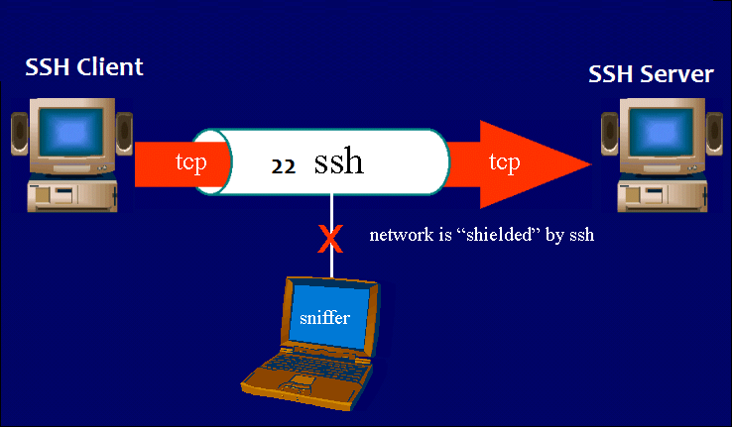
SSH
ssh stands for “Secure Shell”. It is a protocol used to securely connect to a remote server/system.
ssh is secure in the sense that it transfers the data in encrypted form between the host and the client.
It transfers inputs from the client to the host and relays back the output. ssh runs at TCP/IP port 22
ssh user_name@host(IP/Domain_name) Example: ssh root@192.168.1.1

Slide 34
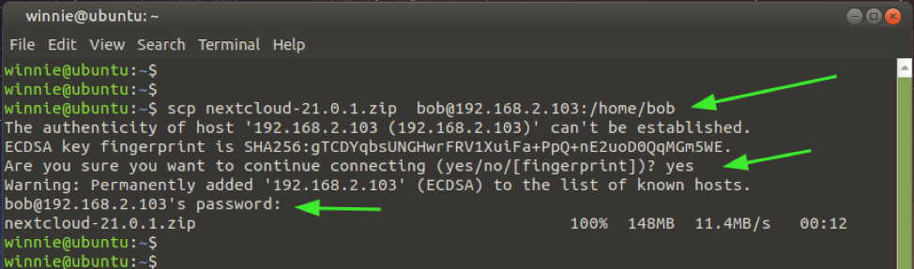
SCP
The scp command allows you to copy files over ssh connections.
This is pretty useful if you want to transport files between computers
Syntax
scp examplefile yourusername@yourserver:/home/yourusername/
Example
scp file1.pdf root@192.168.1.1:/root/Desktop

Slide 35
References
https://en.wikipedia.org/wiki/Linux_kernel
https://www.tutorialspoint.com/operating_system/os_linux.html
https://buildmedia.readthedocs.org/media/pdf/lym/latest/lym.pdf
https://phoenixnap.com/kb/linux-commands-cheat-sheet
https://www.guru99.com/file-permissions.html
https://www.hostinger.in/tutorials/linux-commands

Slide 36
THANK YOU

